Slide 1
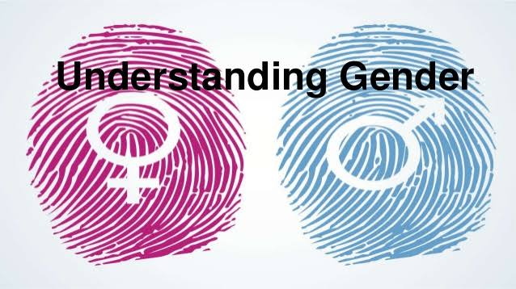

Slide 2

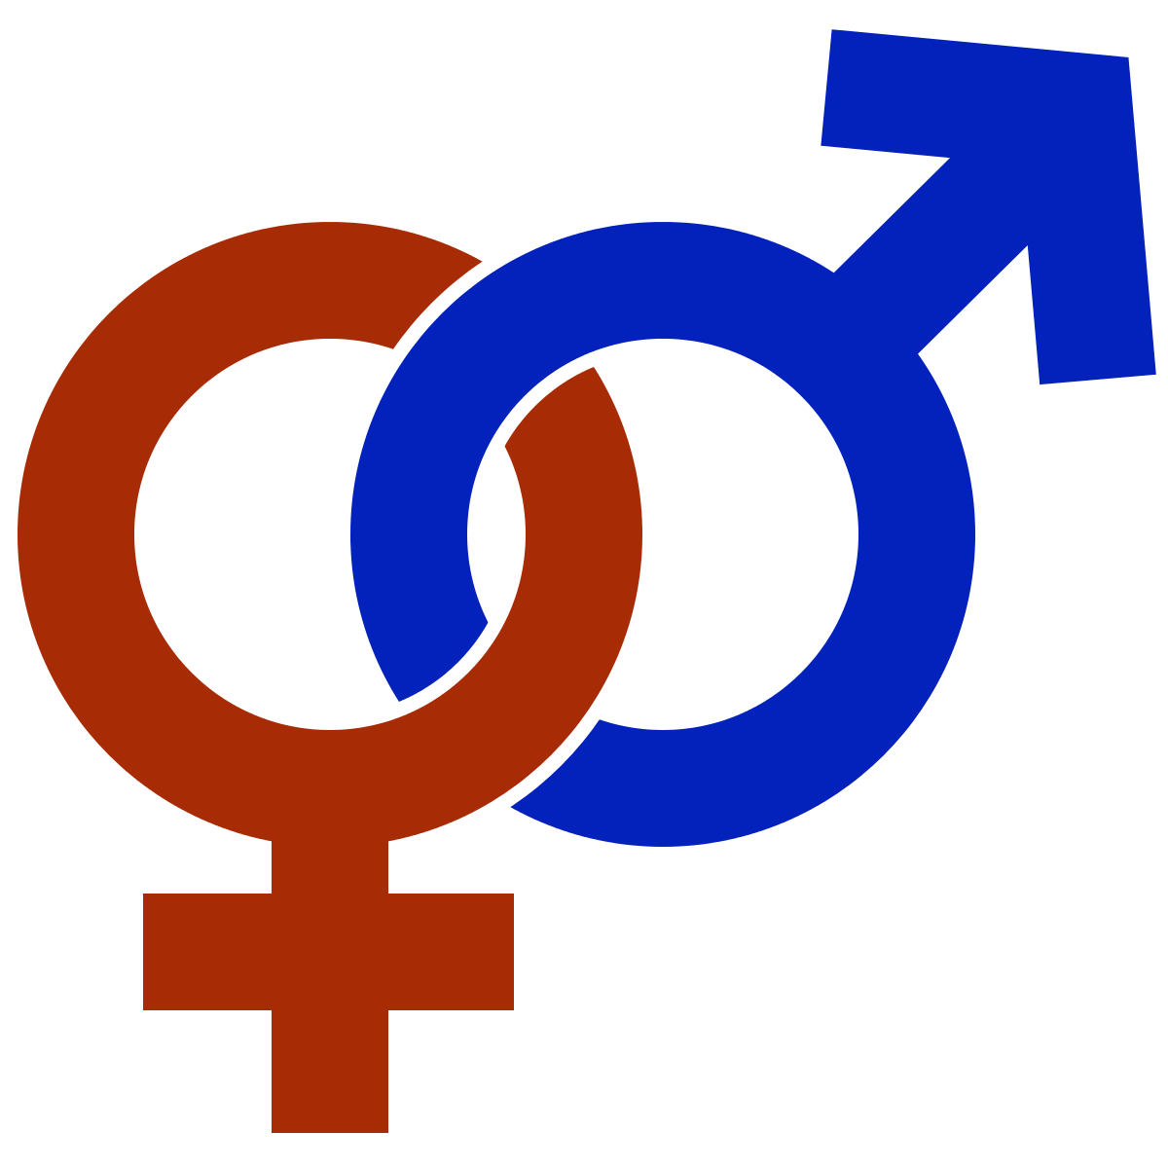
Topics
Definition of Gender
Basic Gender Concepts and Terminology
Exploring Attitudes towards Gender
Construction of Gender
Socialization:
Making Women, Making Men
Preparing for Womanhood.
Growing up Male.

Slide 3
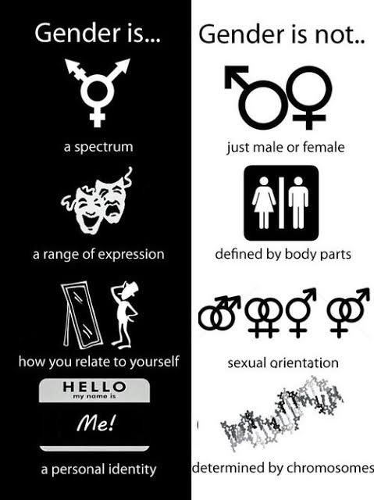
Definition of Gender
Gender is the state of being male or female in relation to the social and cultural roles that are considered appropriate for men and women. It is illegal to discriminate on the grounds of race, gender or sexual orientation.

Slide 4
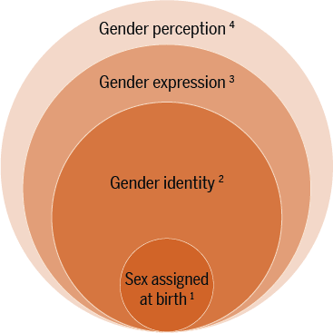
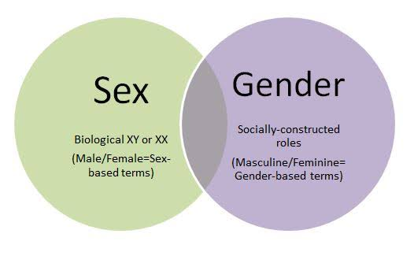
Basic Gender Concepts and Terminology
1)Sex and Gender
2)Gender roles
3)Gender needs
4)Transgender
Sex and Gender
Notes:
Sex and Gender Sex : The biological difference between men and women, boys and girls – the physical attributes with which we are born. Gender : Culturally and socially constructed roles, responsibilities, privileges, relations and expectations of women, men, boys and girls. Gender is not another word for women. Gender is also not another word for sexual difference. Transgender Transgender (TG) is generally described as an umbrella term for persons whose gender identity, gender expression or behavior does not conform to their biological sex. TG may also take in persons who do not identify with their sex assigned at birth, which include Hijras/Eunuchs who describe themselves as - "third gender" and they do not identify as either male or female.

Slide 5
Gender gap
Gender bias
Gender discrimination
Societal Perpetration
Domestic Violence
Sexual Harassment at Workplace.
Gender roles
Problems
Gender stereotyping
Gender Role Perception
Goals
Gender equity
Gender mainstreaming
Gender neutral
Gender needs
Practical gender needs
Strategic gender needs
Notes:
Gender roles Gender roles : The different tasks and responsibilities and expectations that society defines and allocates to men, women, boys and girls. These are not necessarily determined by biological differences and therefore can change with time and in different situations. Gender stereotyping : The assignment of roles, tasks and responsibilities to a particular gender on the basis of preconceived prejudices. For instance the assumption that masons can only be men or that nurses are necessarily women. Gender Role Perception : Different roles and characteristics are assigned to people not only on the basis of their gender, but of their race, caste, class, ethnic background and age. Gender gap : Differences between men and women in levels of achievement or access. This could for example be access to education or health care and treatment services or differentials in wages paid to women and men. These differentials may result from customary practices, religious biases, social assumption, myths or taboos, among others. Gender discrimination: Where one gender is favoured and the other becomes disadvantaged e.g. sex selective abortion. Gender oppression: Where one gender dominates the other unjustly or even cruelly. For instance, domestic violence, rape, sexual harassment. Gender bias : An approach that treats boys and girls differently. For instance differential treatment seeking behaviour in case of illness. Gender equity : An approach that results in just/ fair treatment of women and men, and recognition and appreciation of both women‘s and men‘s potential. For instance giving bicycles to girls to enable them to travel to a distant school and thereby reduce gender gaps in the drop-out rate. Gender mainstreaming : The process of assessing the implications for women and men of any planned action, including legislation, policies or programmes, in any area and at all levels. It is a strategy for making the concerns and experiences of women as well as of men an integral part of the design, implementation, monitoring and evaluation of policies and programmes in all political, economic and societal spheres, so that women and men benefit equally, and inequality is not perpetuated. The ultimate goal of mainstreaming is to achieve gender equality. Gender neutral : An approach to planning and policy making that assumes that the impact on women, men, girls and boys as if they were part of one homogeneous group. For instance, although men are usually taller than women, fixing the height of the podium in conference halls on the basis of the height of men. Gender needs Practical gender needs : Needs which are related to satisfying basic and material needs of women and men, girls and boys for their day-to- day survival, and which do not change gender patterns. For instance public provisioning of water inside the home or providing access to creche facilities at the workplace. Strategic gender needs : Needs that are related to changing the situation of marginalised people, especially women. Strategic needs may include training women to become Mates at MGNREGA worksites or giving registering land in the name of women and men as with joint pattas or addressing issues of domestic violence, legal rights, equal wages, and women‘s control over resources.

Slide 6
Exploring Attitudes towards Gender
'Cultural Rules' for Women
Don't inherit land or property, and never head a household.
Don't seek work outside the home unless the man says it necessary.
Don't aim high in promotion and never opt for careers eg. the mass media, mining, commercial vehicle driving, engineering, etc.
Never meddle in politics or aspire to high offices of leadership.
Families
Marriage and Divisions of Labour
Study
Job
'Cultural Rules' for men
Do not cry, cook.
Don't enter the kitchen - or you will turn into a chicken.
Don't go to the well - because it will dry up.

Slide 7
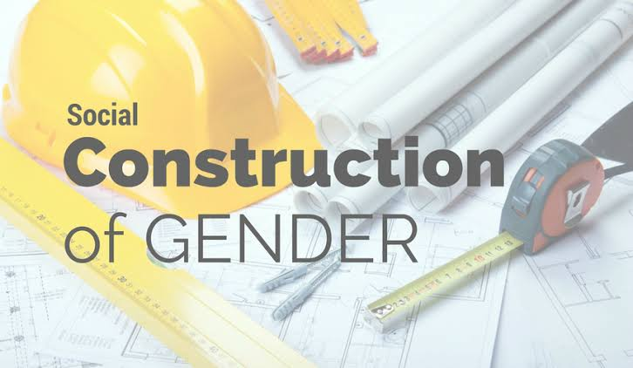
Birth
Gender Construction
Naming, clothing
Experiences
Working
Notes:
For the individual, gender construction starts on the basis of look like at birth. A sex category becomes a gender status through naming, dress, and the use of other gender makers. Parenting is gendered, with different expectations for people of different genders work at different kinds of jobs. The work adults do as mothers and fathers and as low-level workers and high-level bosses, shapes women's and men's life experiences, and these experiences produce different feelings ,consciousness, relationships, skills - way of being that we call feminine or masculine. All of these process constitute the social construction of gender.

Slide 8
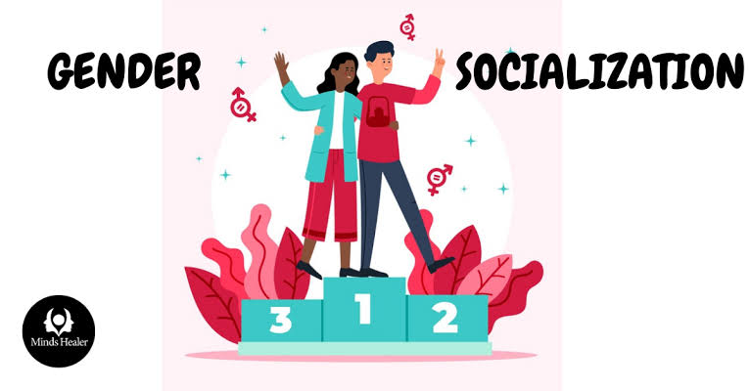
Socialization: Making Women, Making Men
Gender socialization is the process by which individuals are taught how to socially behave in accordance with their assigned gender, which is assigned at birth based on their biological sex.
Gender stereotypes can be a result of gender socialization
Notes:
Today it is largely believed that most gender differences are attributed to differences in socialization, rather than genetic and biological factors. Gender stereotypes can be a result of gender socialization: Gender stereotypes evolve based on a culture’s belief systems regarding the attitudes, behaviors, and other characteristics that seem to differentiate the two sexes. Gender stereotypes are the beliefs that people have about the characteristics of males and females. The content of stereotypes varies over cultures and over time. Children's gender stereotypes of activities and occupations develop quickly during the preschool years.

Slide 9
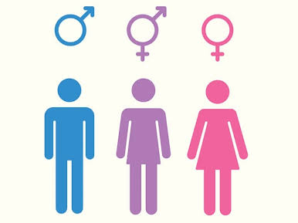
Preparing for Womanhood
Growing up Male
The state of being a woman.
Traits such as sensitivity, supportiveness, gentleness, warmth,cooperativeness, expressiveness, empathy, affection, tenderness, and being emotional, kind, helpful, devoted,understanding etc, have been cited as stereotypically feminine.
Along with it, education, career, leadership, politics make a strong womanhood.
Growing up male is not just biologically, but also mentally, socially and accepting women as equal with. And giving freedom in every aspect.
This results in a social construction of gender where everyone has equal rights beyond the gender.

Slide 10
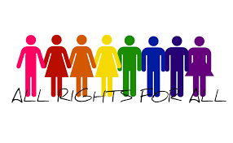
T H A N K Y O U
🇮🇳
Jai Hind

